Slide 1
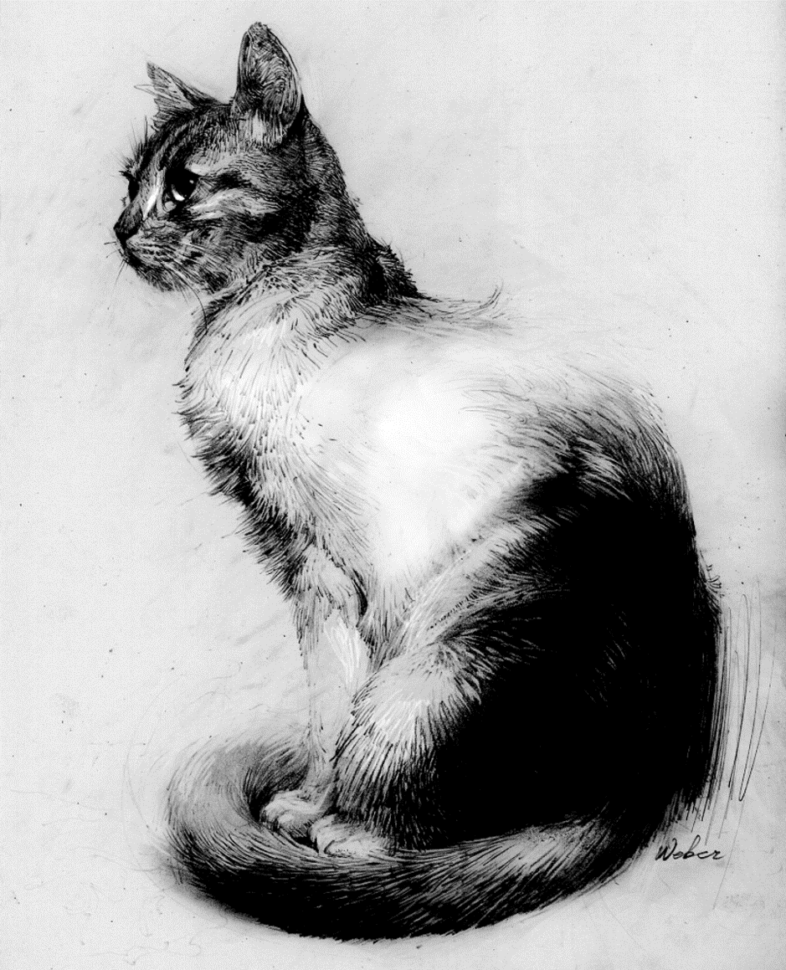
NOBODY WANTS TO BE A COPYCAT

Slide 3
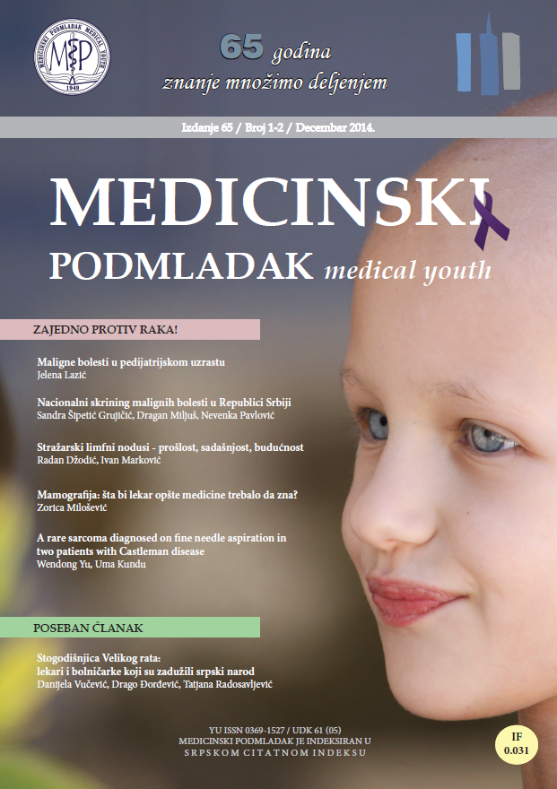
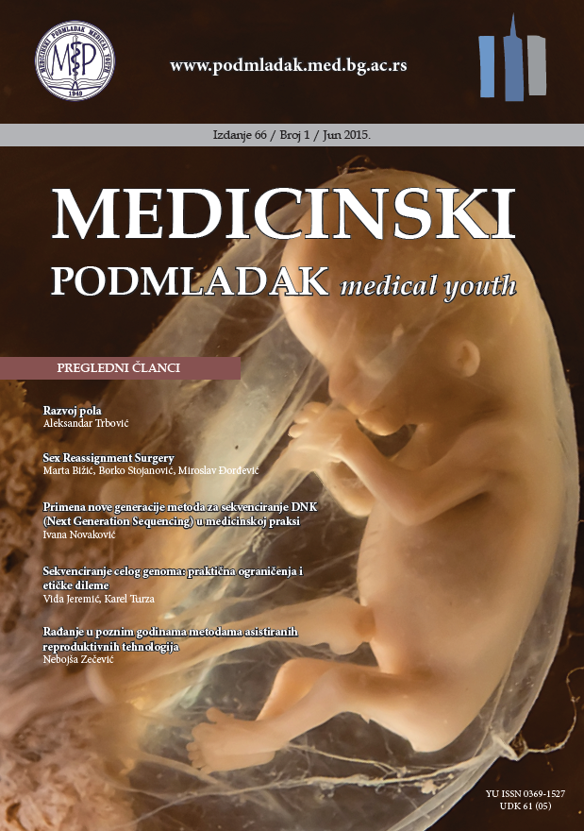
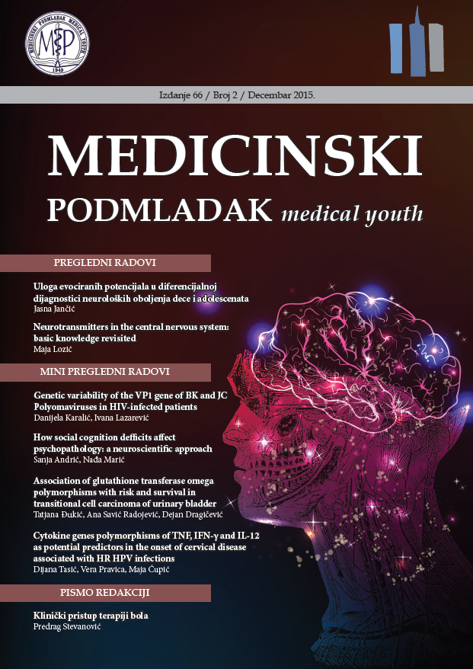
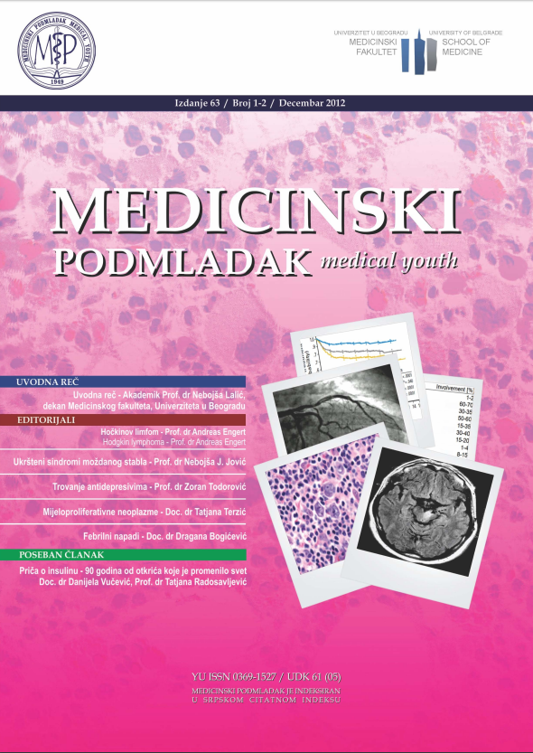
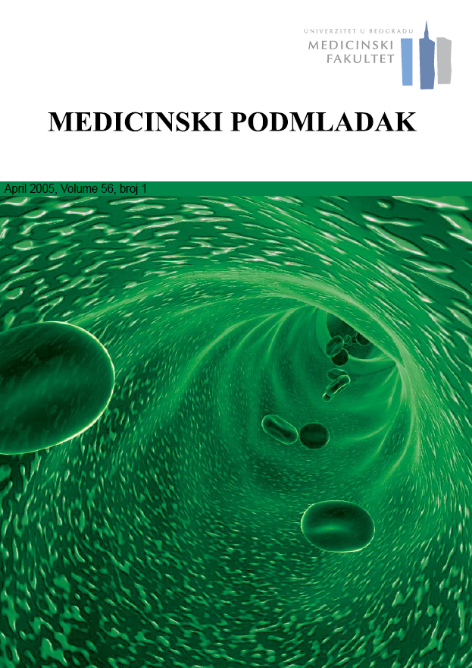
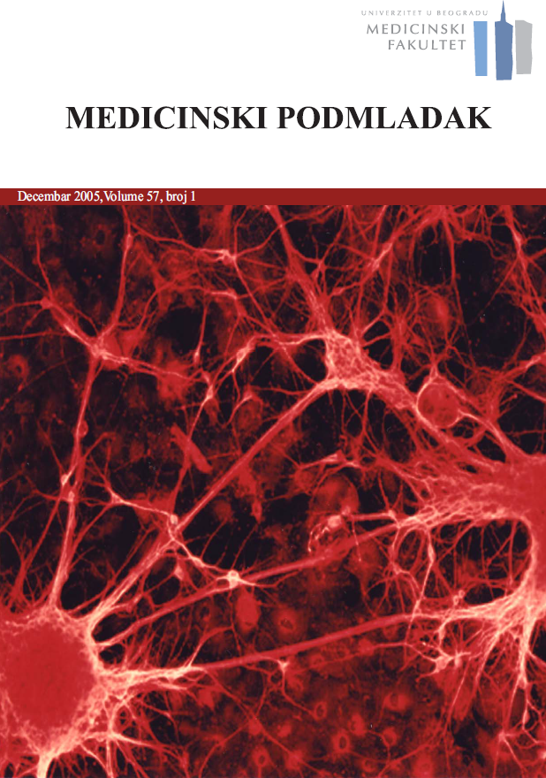
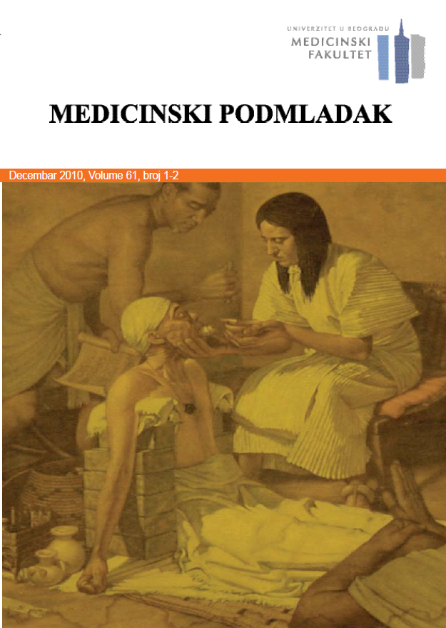
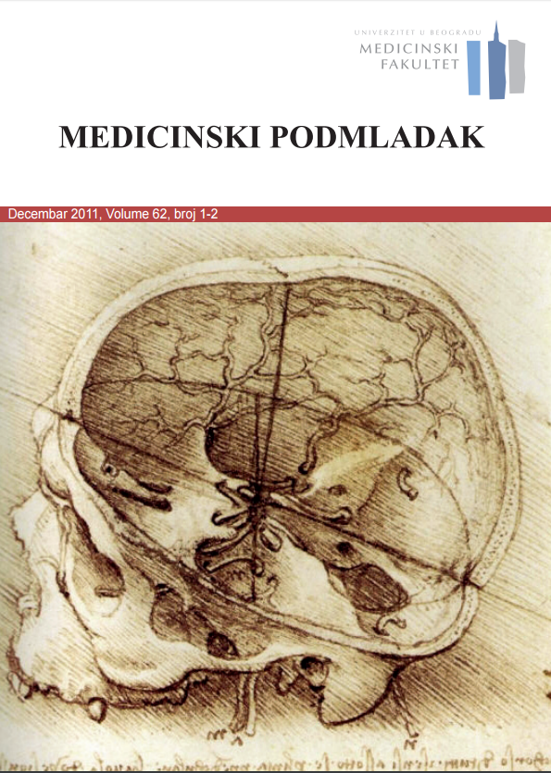
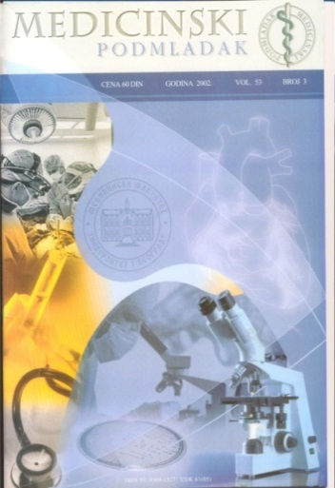
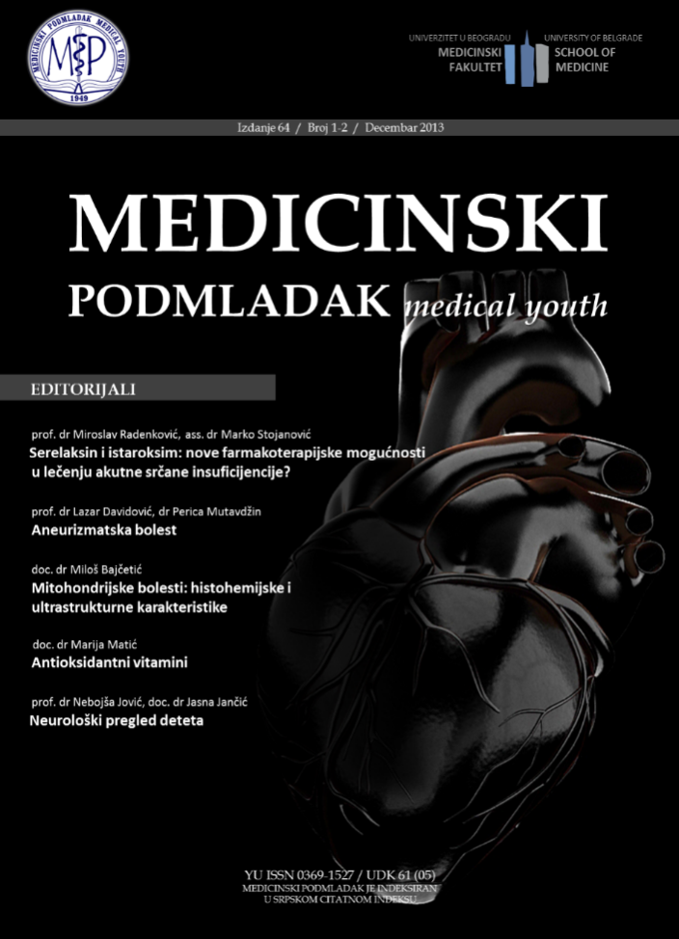
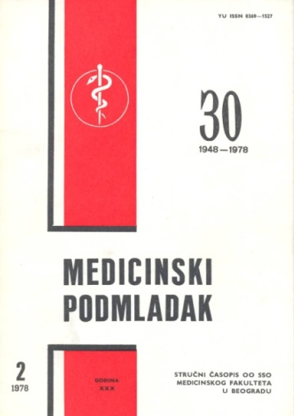
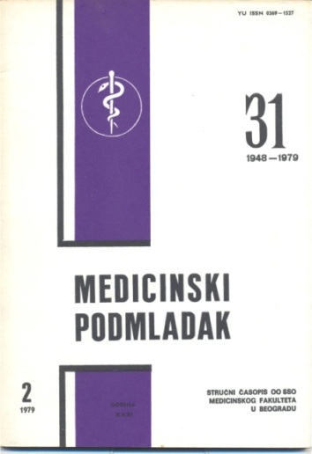
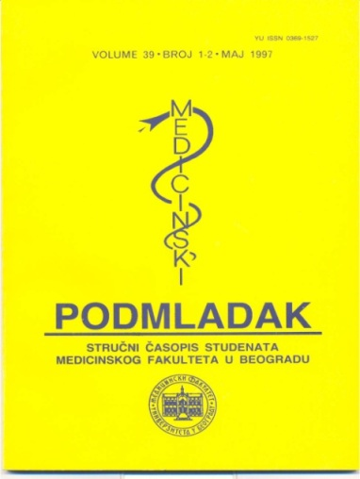
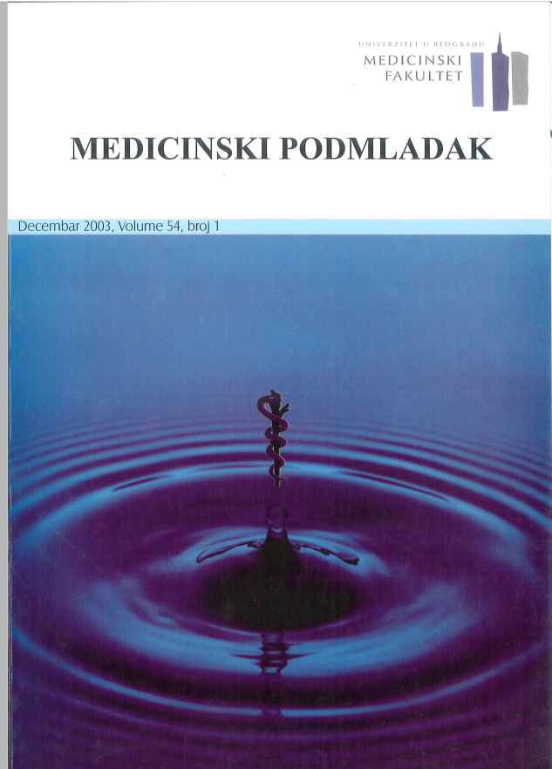
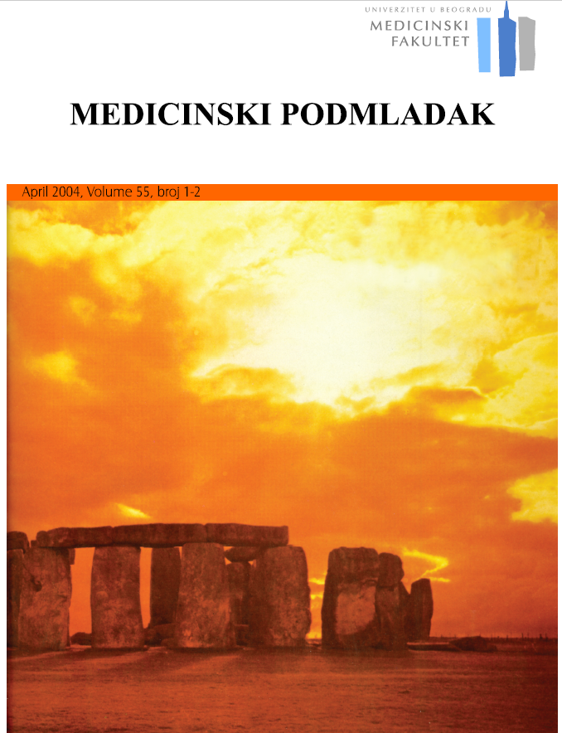
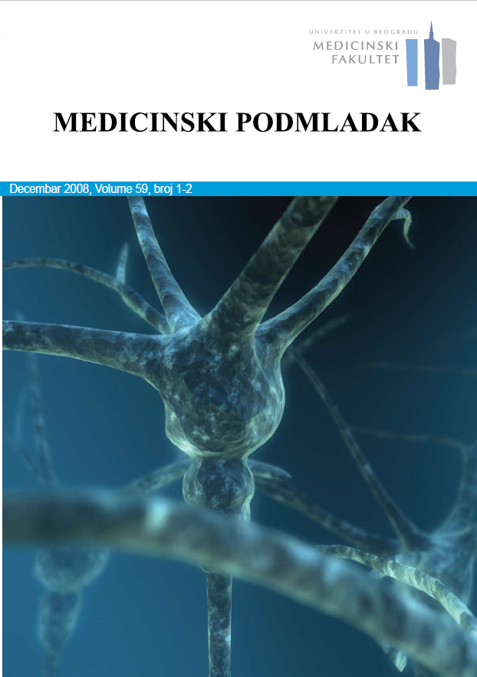
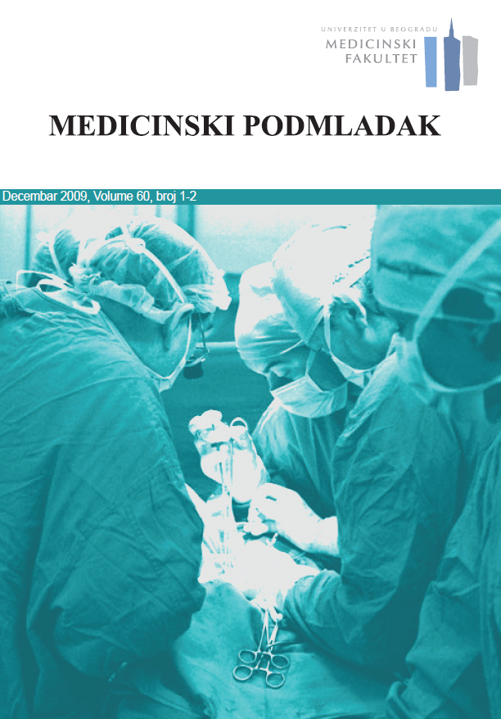
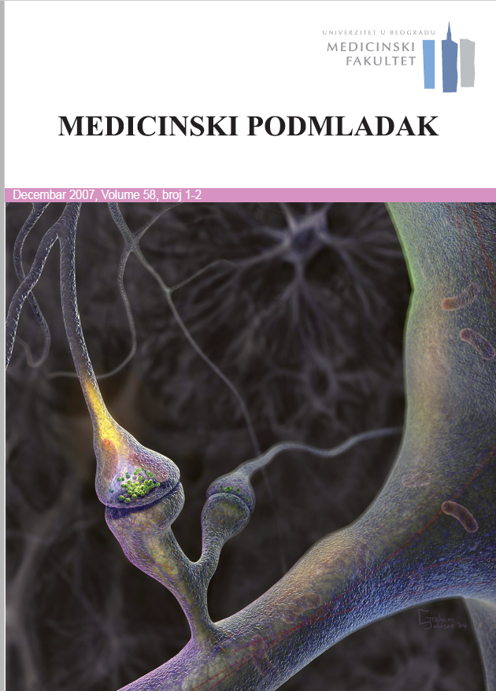

Slide 4
The process of writing – building the article
Title & Abstract
Conclusion
Introduction
Methods
Results
Discussion
Figures/Tables (your data)
IMRAD structure

Slide 5
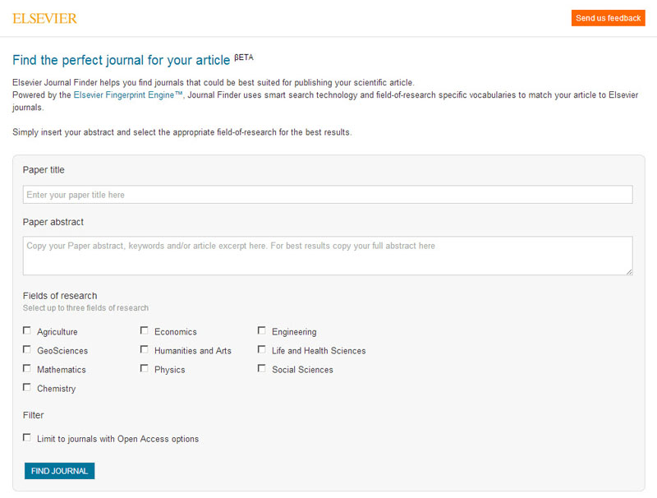

Slide 6
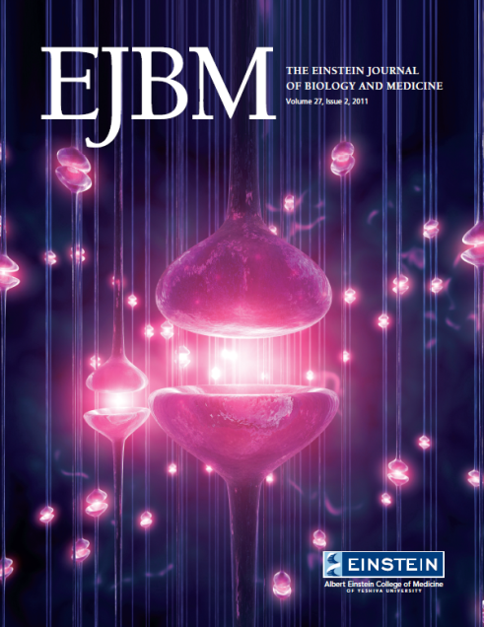
Students’ Journals

Slide 7
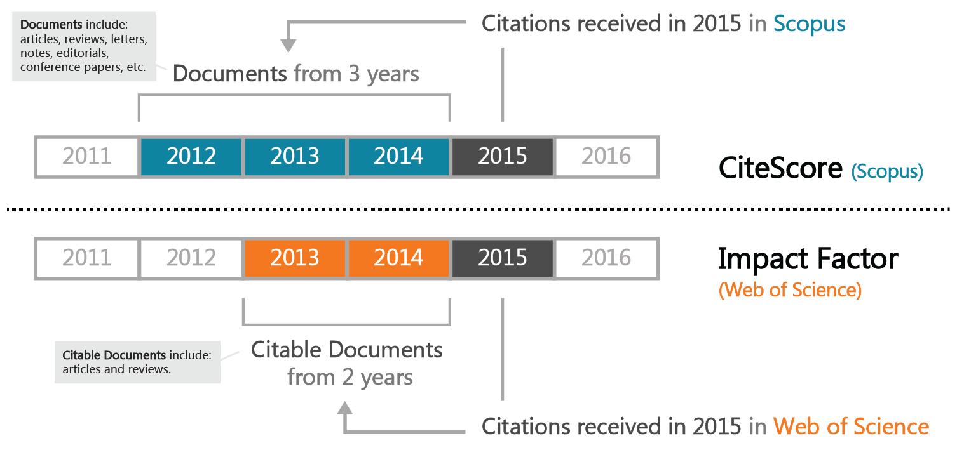
Two Main Academic Literature Collections
Web of Science (Impact Factor)
Scopus Databases (CiteScore)
Notes:
Web of Science (WOS), products from “Thomson Reuters Institute of Scientific Information” (ISI), arises from
the Science Citation Index created by Eugene Garfield in 1960s. WOS includes above 10,000 journals.
Scopus, officially named SciVerse Scopus, has introduced by Elsevier in November 2004 to the information
market. Scopus is the largest database existing on the market for multidisciplinary scientific literatures. Obuhvata preko 20 000 časopisa.

Slide 8
IMPACT FACTOR
a measure reflecting the yearly average number of citations to recent articles published in that journal

Slide 9
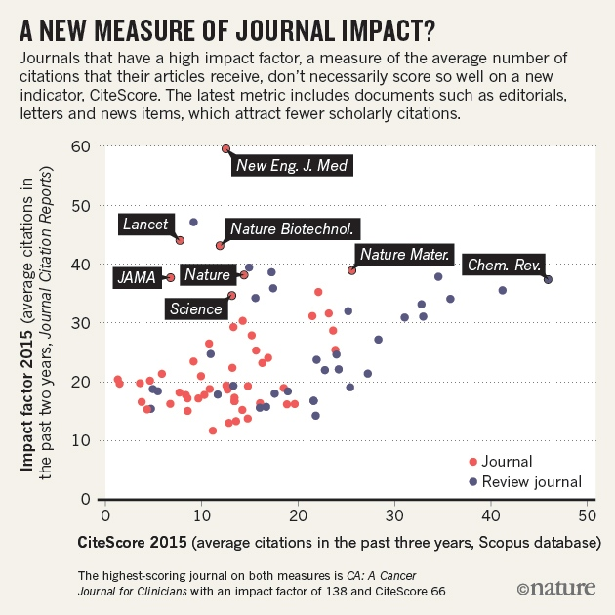

Slide 10
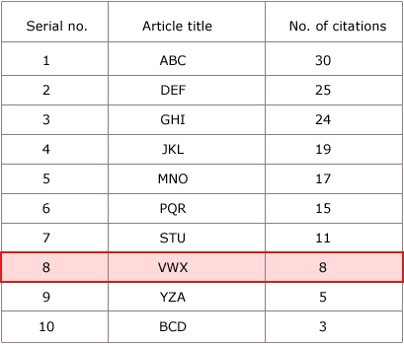
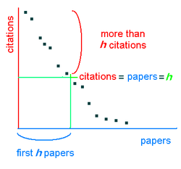
Impact Factor
CiteScore
h-index …
The h-index is an author-level metric that attempts to measure both the productivity and citation impact of the publications of a scientist or scholar. The index is based on the set of the scientist's most cited papers and the number of citations that they have received in other publications.
“Not everything that counts can be counted, and not everything that can be counted counts”.
Sign hanging in Einstein’s office in Princeton University
Notes:
Frojd ima najveci h index – 269 (citiran je skoro 500 000 puta)

Slide 11
“Impact Factor is not a perfect tool to measure the quality of articles but there is nothing better and it has the advantage of already being in existence and is, therefore, a good technique for scientific evaluation. Experience has shown that in each specialty the best journals are those in which it is most difficult to have an article accepted, and these are the journals that have a high impact factor. Most of these journals existed long before the impact factor was devised. The use of impact factor as a measure of quality is widespread because it fits well with the opinion we have in each field of the best journals in our specialty.”
Hoeffel C. Journal impact factors [letter]. Allergy, December, 1998.

Slide 12
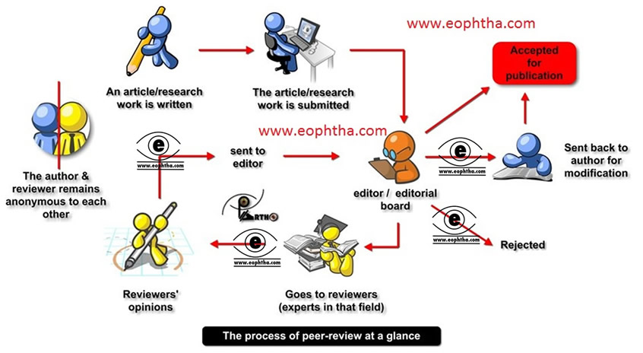
Review process (peer review)

Slide 13
Diagnosis: PLAGIARISM
Notes:
Plagium (latinski) – kidnapovanje coveka

Slide 14
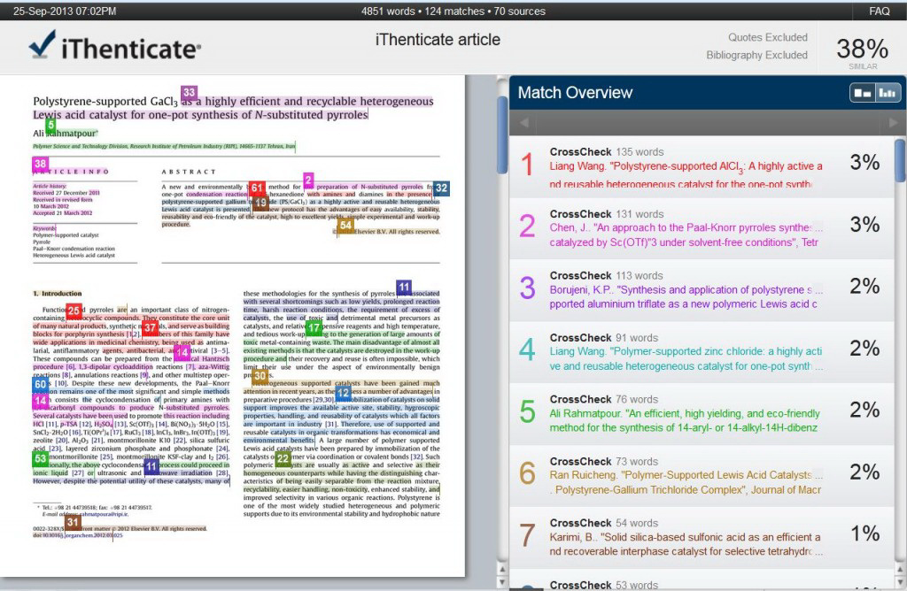
Notes:
Uploaded files are compared to more than 40 million published research articles from 590+ global scientific, technical and medical publishers.
iThenticate searches for content matches in the following 30 languages: Chinese (simplified and traditional), Japanese, Thai, Korean, Catalan, Croatian, Czech, Danish, Dutch, Finnish, French, German, Hungarian, Italian, Norwegian (Bokmal, Nynorsk), Polish, Portuguese, Romanian, Serbian, Slovak, Slovenian, Spanish, Swedish, Arabic, Greek, Hebrew, Farsi, Russian, and Turkish. Please note that iThenticate will match text between text of the same language.

Slide 15
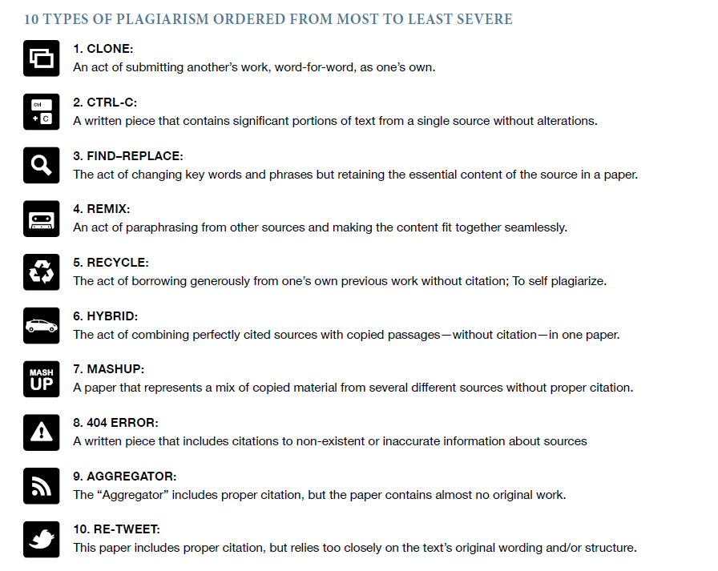

Slide 20
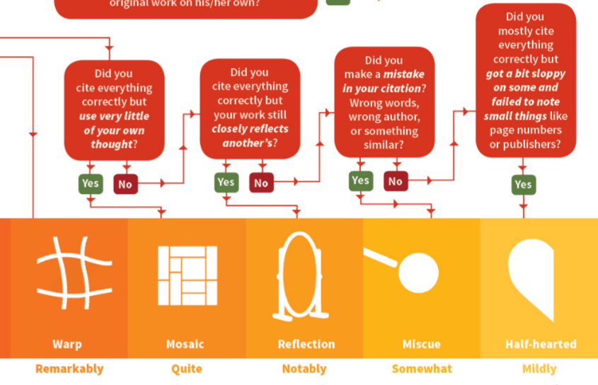

Slide 21
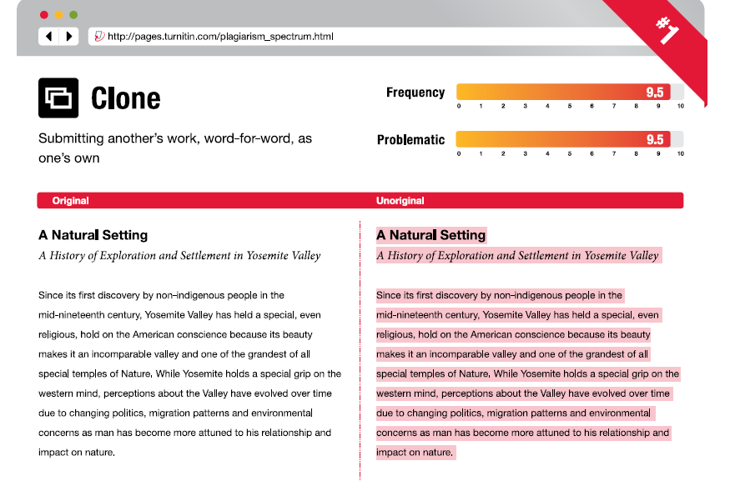
Notes:
As part of this study, Turnitin surveyed both higher and secondary education instructors to take a measure of how
prevalent and problematic these instances of plagiarism are among their students. The Plagiarism Spectrum ranks the
types of plagiarism by intent and then provides data on the prevalence and problematic nature of type based on the
feedback from 879 survey respondents.

Slide 22
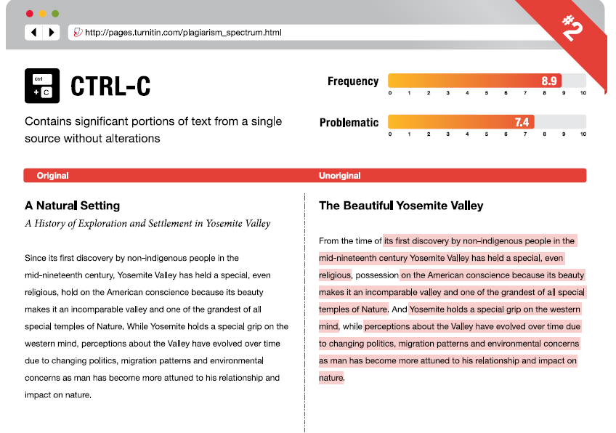

Slide 23
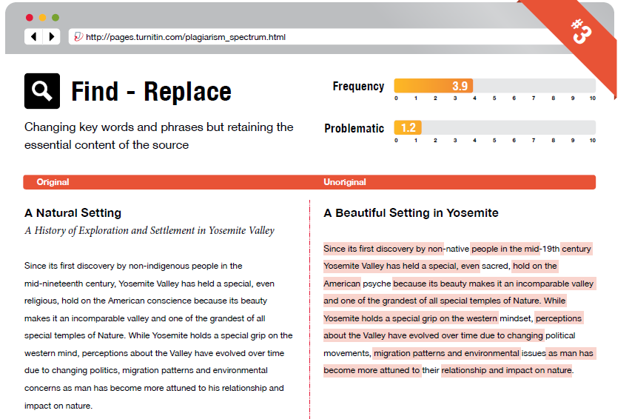

Slide 24
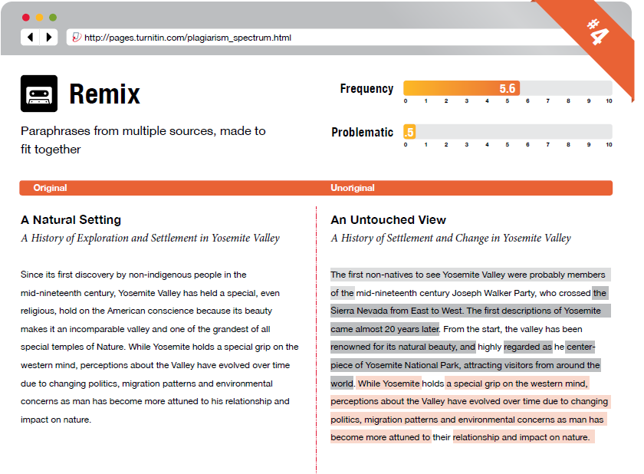

Slide 25
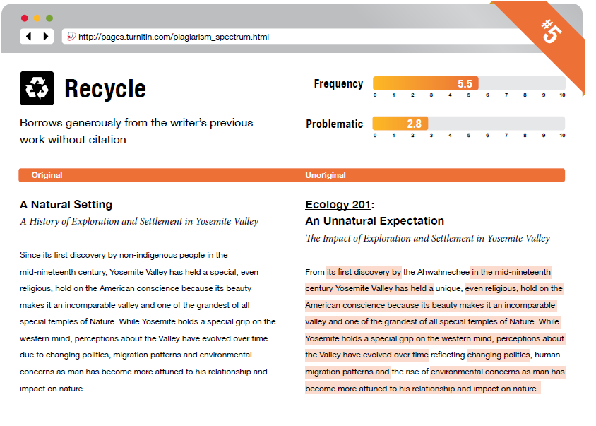

Slide 26
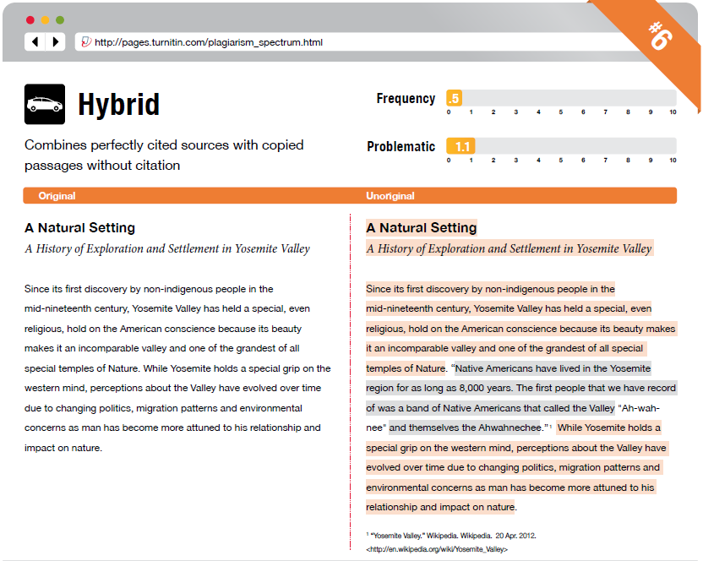

Slide 27
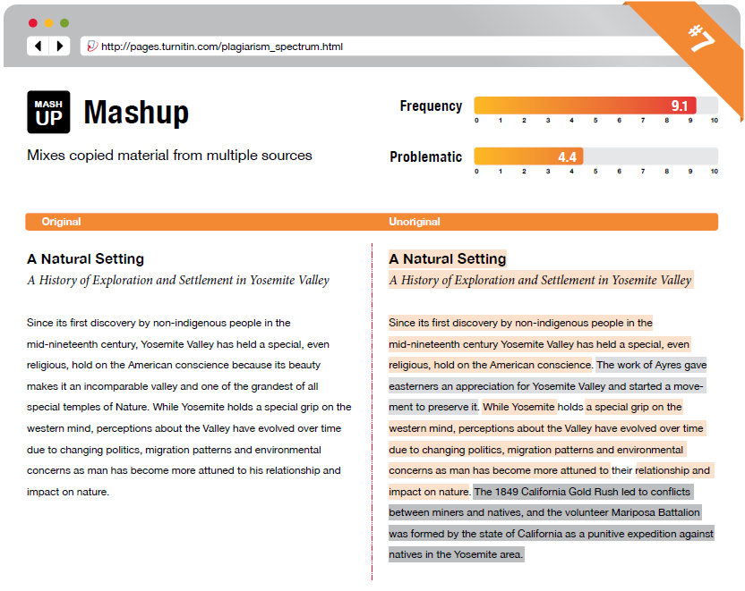

Slide 28
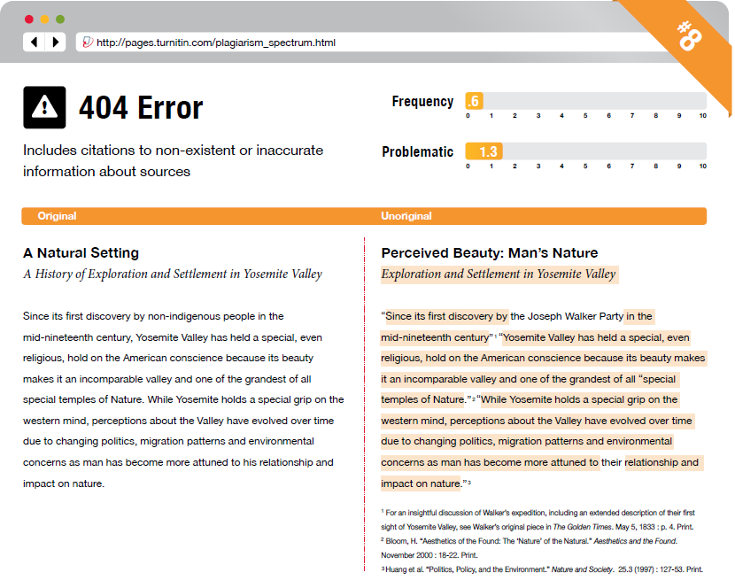

Slide 30
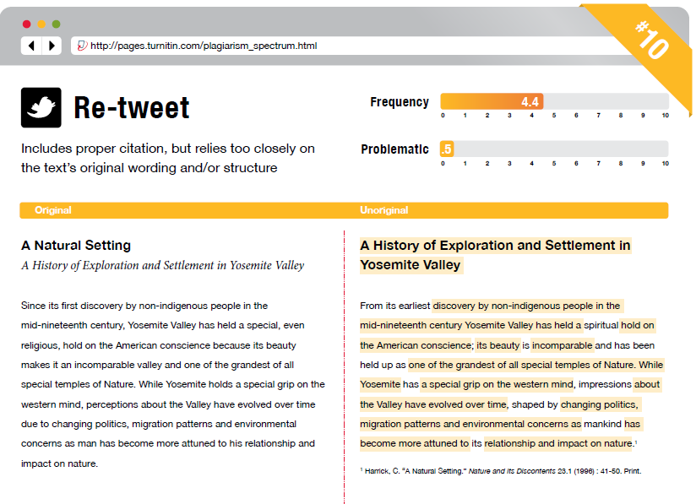

Slide 31
Klon (salama, frakcionisan, duplikat)
Von Elm et al. 1131 rad: 60x2, 13x3, 3x4, 2x5
Lančana reakcija
Hvatač pažnje
Igra s vatrom
Zamka
Zombi
COMMON KNOWLEDGE!
Notes:
Igra sa vatrom (slanje u vise casopisa istovremeno)
Zamka (napad na kolege)
Common knowledge – ne mora da se citira jer je opste poznato (ubikvitarno I moze se naci na vise mesta); ako nismo sigurni bolje je citirati
Zombi (never dies, stalno opet salje iako je odbijen)

Slide 32
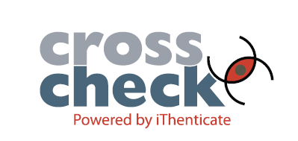
CROSSCHECK
Similarity Score
Similarity Report
Content Tracking
Side-by-side Comparison
Primer:
Similarity Score: 25%
Similarity Report:
Izvor A: 20%
Izvor B: 5%
Content Tracking:
Izvor B: 15% (10% je deo teksta iz Izvora A i na taj način je maskirano tako da ga Similarity Report ne prepoznaje)

Slide 33
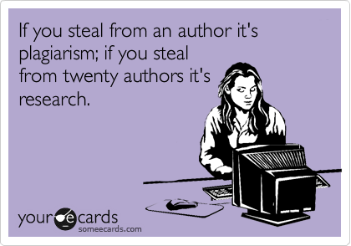
Notes:
Naravno, ukoliko je citirano kako treba I ukoliko je rad originalan I znacajan za nauku

Slide 34
Želite da objavite svoj rad?
Cover letter
Literature Review Update
Electronic Submission of Manuscript
Uputstvo za autore
ASEESTANT (sistem elektronskog uređivanja časopisa )
Notes:
Kada izberete casopis, vazno je procitati Uputstvo (skratiti muke i sebi i uredniku i recenzentima)

Slide 35
Attention to details
Check and double check your work
Consider the reviewers’ comments
English must be as good as possible
Presentation is important
Take your time with revision
Acknowledge those who have helped you
New, original and previously unpublished
Critically evaluate your own manuscript
Ethical rules must be obeyed
Nigel John Cook
Editor-in-Chief, Ore Geology Reviews

Slide 36
‘’Most people say that it is the intellect which makes a great scientist. They are wrong: it is character.”
Albert Einstein, scientist

